Slide 1
IT WORKSHOP II
COLLEGE MANAGEMENT APP USING FLUTTER
PROJECT MEMBERS
SAHASRANSHU SINGH - BT20ECE046
ALOK KUMAR - BT20ECE047
MOHIT CHAUDHARY - BT20ECE056
SHWETHA MANASWINI - BT20ECE073
RUTUJA SANAP - BT20ECE042

Slide 2
INTRODUCTION
The college management application based on flutter using dart language ,in application used firebase and fire authentication database.
This application deals with various modules like student module in which we can get the details about the students .Second module is the teacher in which we can get details about teachers and last is admin module in which we can manage the students and teacher details.

Slide 3
LOGIN PAGE
STUDENT MODULE
TEACHER MODULE
Can see notice
EXAM
Can post notice
List of Students
Posts
RESULT
ATTENDANCE

Slide 4
IMPLEMENTATION
When user open this app then in first page we can see the registration/login page.

Slide 5
STUDENT MODULE
In this module, student can see all their own data and also they can see academic related data in system(which the teacher has posted).
First student can registration them email and then they can login using email and password.

Slide 6
TEACHER MODULE
Firstly teacher also can registration them email and then they can login using email and password.
In this module, teacher can see all their own data and also they can see academic related data in system.
They can post any academic related material or any message to the students.

Slide 7
FUNCTIONALITY
Login using email and password
Registration
Post
Manage Students
See or Post Notices
Logout

Slide 8
CONCLUSION
I conclude the my project, this application is build in flutter using firebase which is user friendly and can access by every student and teachers from the collage
By developing this application, the database and the work load is reduce on the administrator. The application enables the privacy and security to the users.

Slide 9
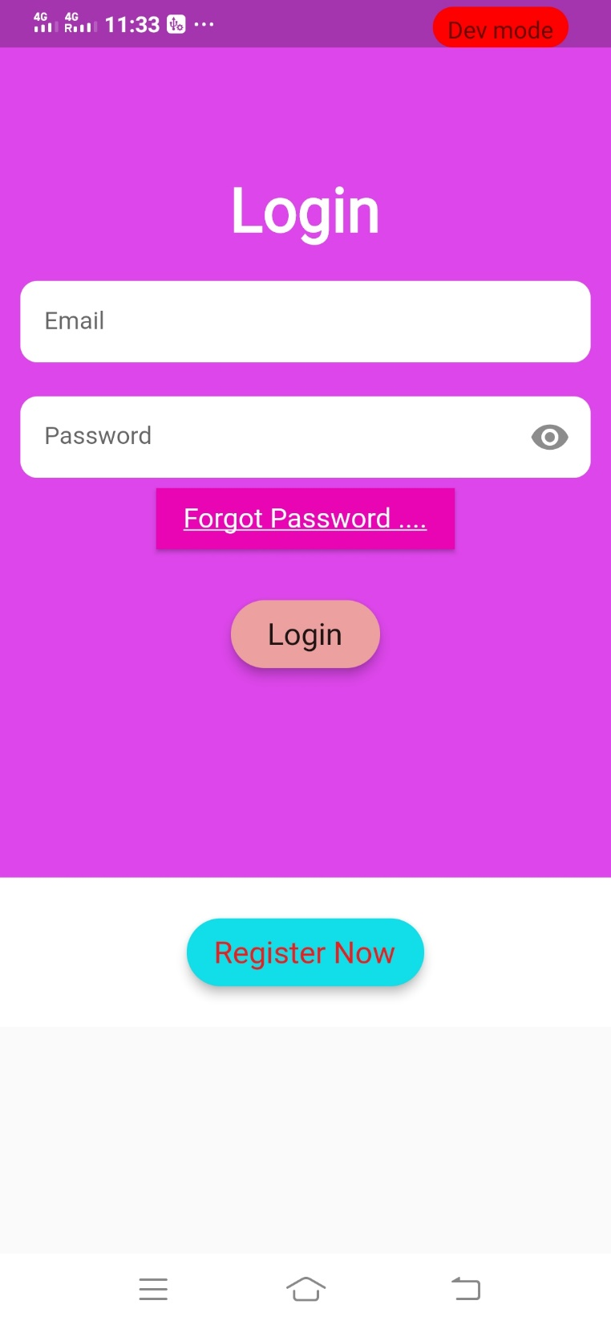
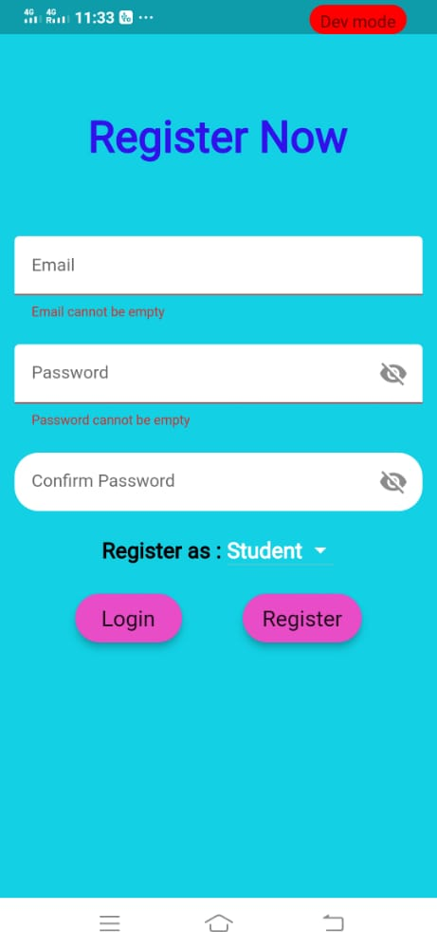
APP IMAGES

Slide 10
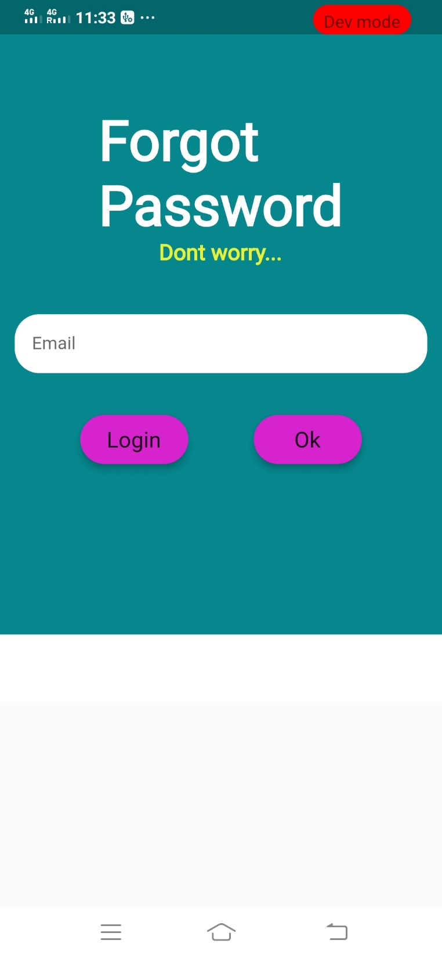
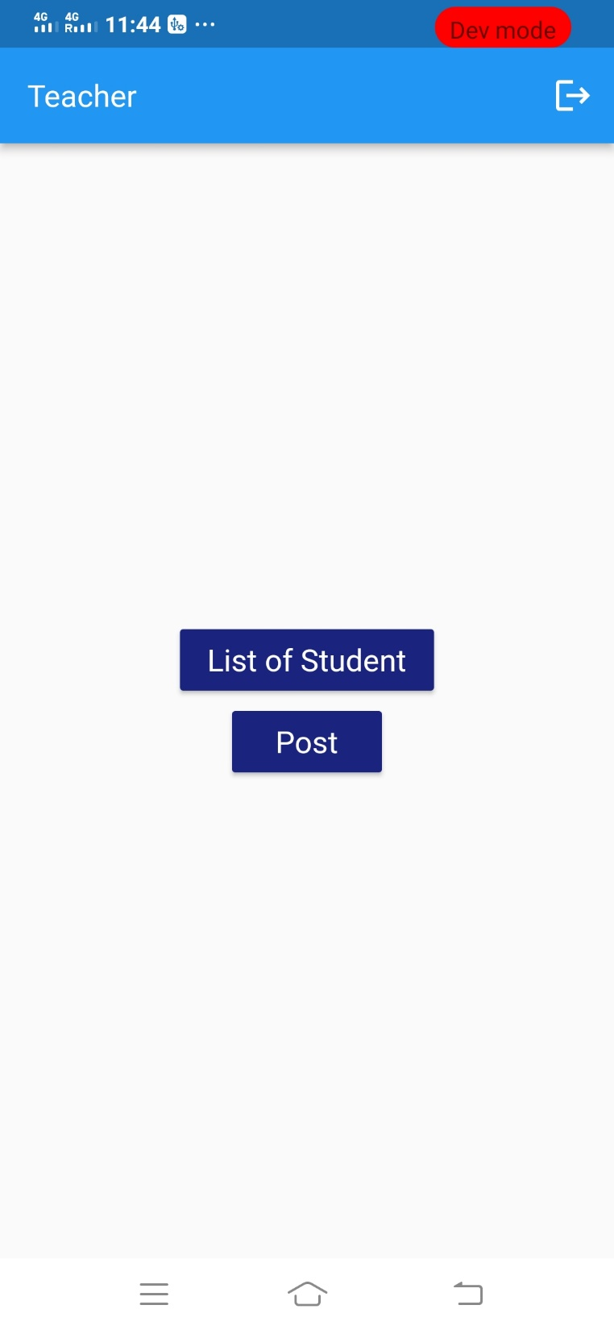
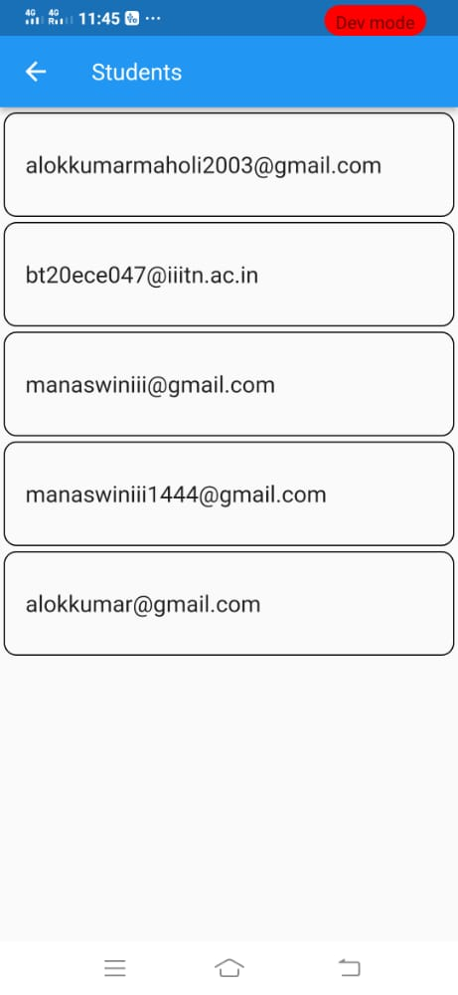

Slide 11
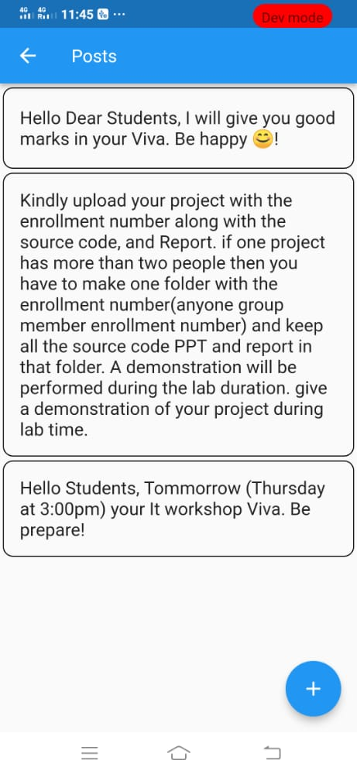
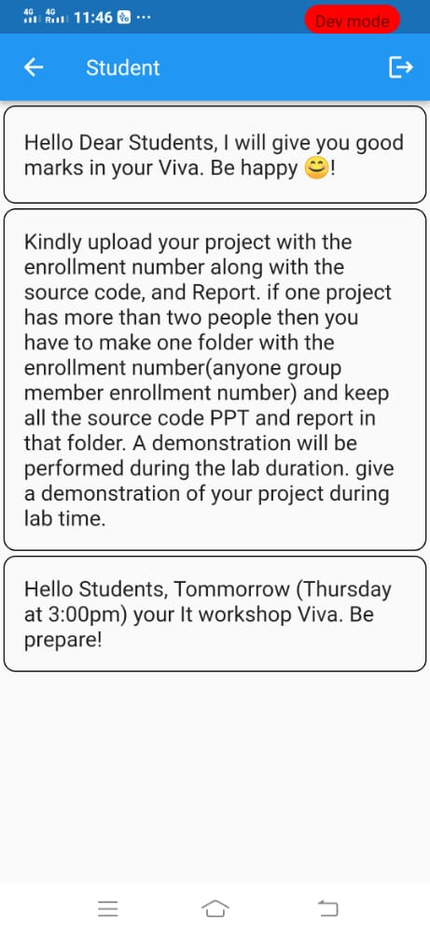

Slide 12
THANK YOU

